Slide 1
Protein folding and what it means for drug discovery
PyData London 2024
Dr. Emlyn Clay. BSc, PhD.

Slide 2
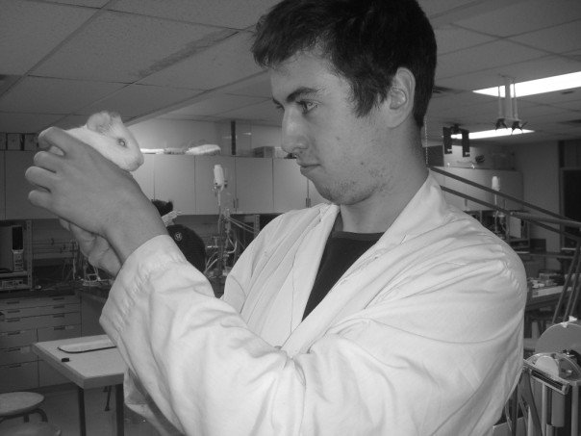
Notes:
BSc, PhD Pharmacology.
We work on figuring how drugs interact in organisms, like guinea pigs and humans.
Modelling the docking of ligands and their receptor is normally the realm of cheminformatics and bioinformatics

Slide 3
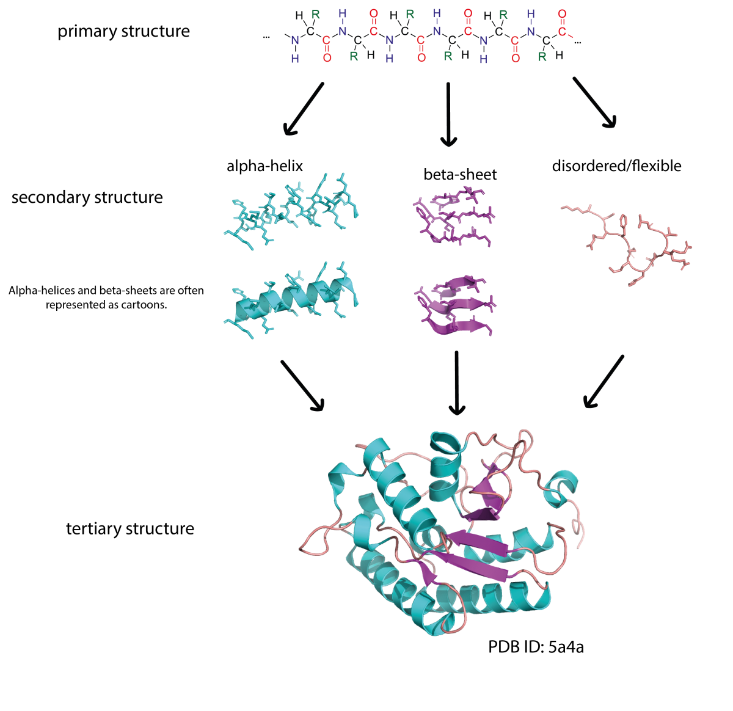
Simone Heber, https://www.scienceinschool.org/article/2021/gaming-cutting-edge-biology-ai-and-protein-folding-problem/
Notes:
Proteins are made up of a string of amino acids that fold, spontaneously,

Slide 4
Why are proteins important for drug discovery?

Slide 5
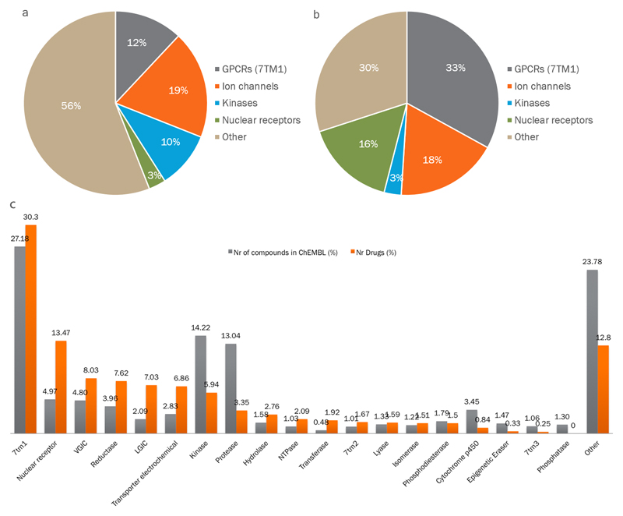
1,727
licensed drugs (BNF, 2024)
88%
Target proteins
A comprehensive map of molecular drug targets, https://www.ncbi.nlm.nih.gov/pmc/articles/PMC6314433/
Notes:
(a) Distribution of human drug targets by gene family. (b) distribution by the fraction of drugs targeting those families; the historical dominance of four families is clear. (c) Clinical success of privileged protein family classes.

Slide 6
Top selling medications (volume)
Proton Pump Inhibitors (PPIs) — Omeprazole
Statins, HMG-CoA reductase — Simvastatin
NSAIDs, COX-dependent inhibition — Paracetamol
Notes:
Proton Pump Inhibitors irreversibly binding to and inhibiting the hydrogen-potassium ATPase pump that resides on the luminal surface of the parietal cell membrane.
HMG-CoA reductase is a rate-controlling enzyme of the mevalonate pathway, the metabolic pathway that produces cholesterol and other isoprenoids.
COX-dependent inhibition cyclooxygenases involved in the formation of prostaglandins. Prostaglandins are potent hyperalgesic mediators.

Slide 7
How do proteins (that we want to drug) work?

Slide 8
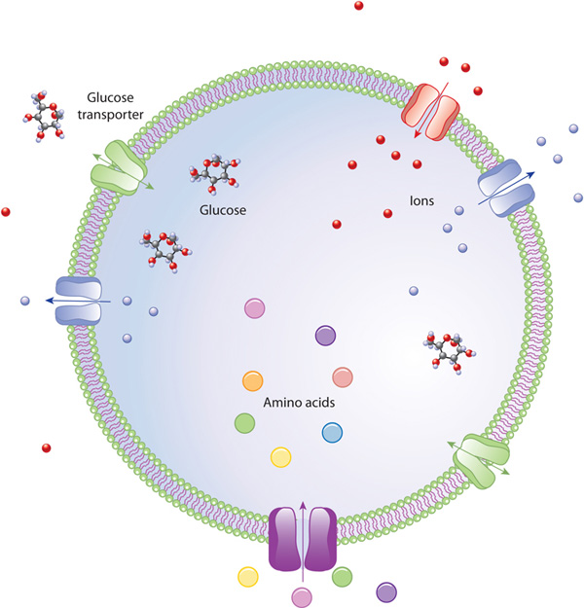
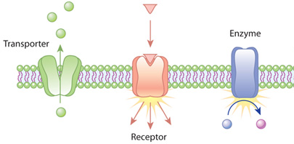
https://www.nature.com/scitable/topicpage/cell-membranes-14052567/
Notes:
Different proteins specialize at different tasks
Emphasis the importance of the shape and conformation!

Slide 9
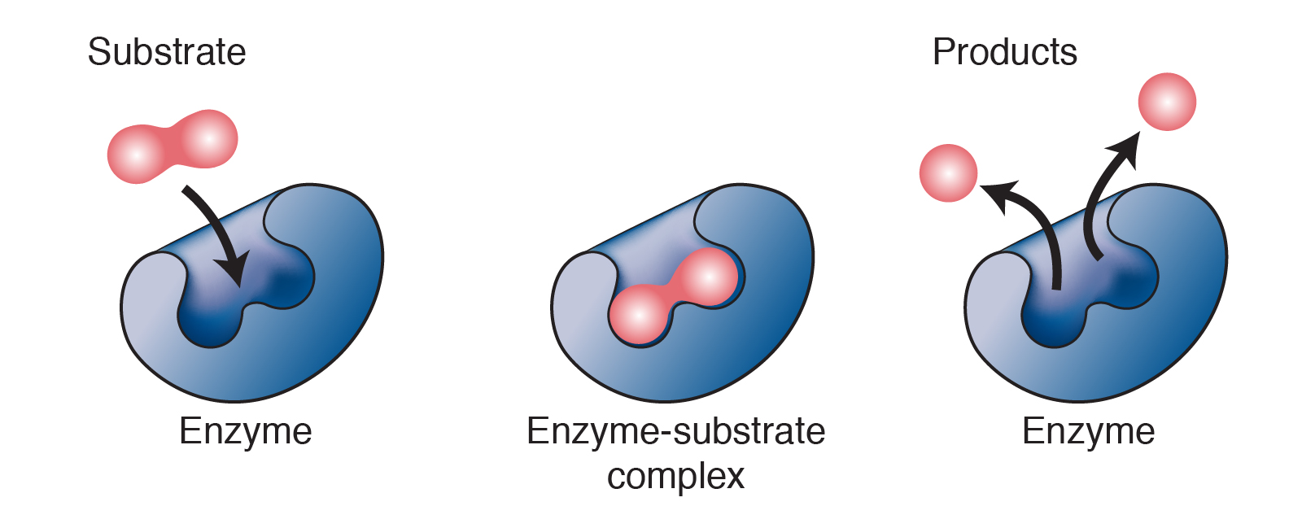
https://www.genome.gov/genetics-glossary/Enzyme
Notes:
Emphasis the importance of the shape and conformation!

Slide 10
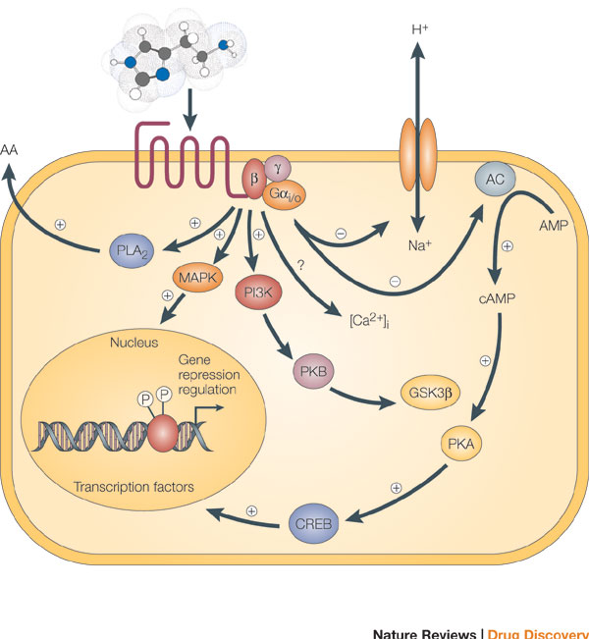
Cell membrane receptors
GPCRs
Ion channels
Kinases
Nuclear receptors
https://www.nature.com/scitable/topicpage/gpcr-14047471/

Slide 11
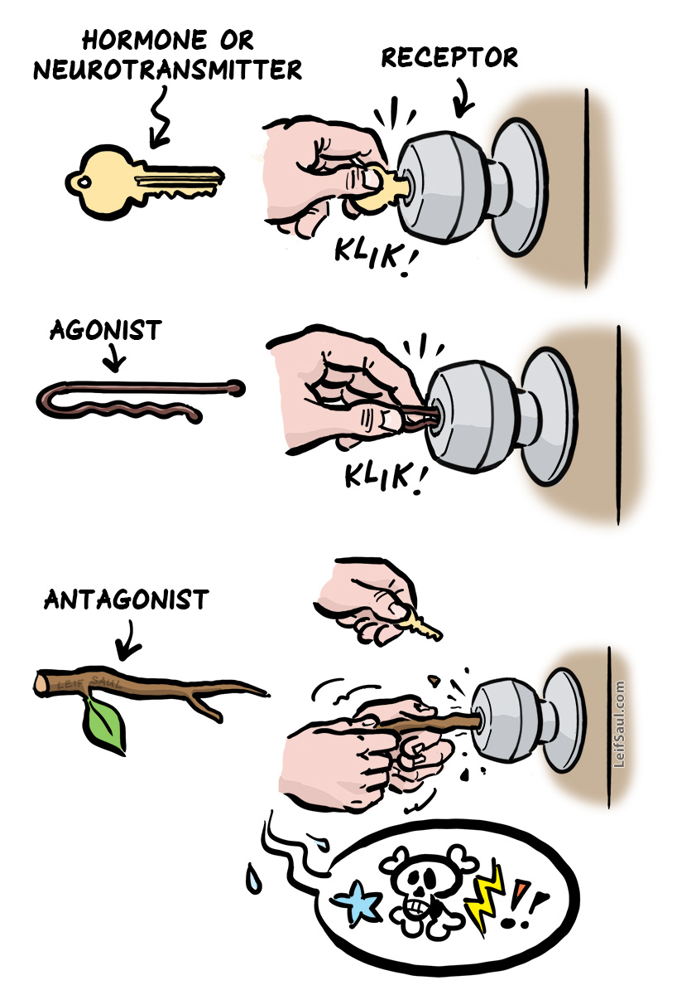
“Lock and Key”
(Fisher, 1894)

Slide 12
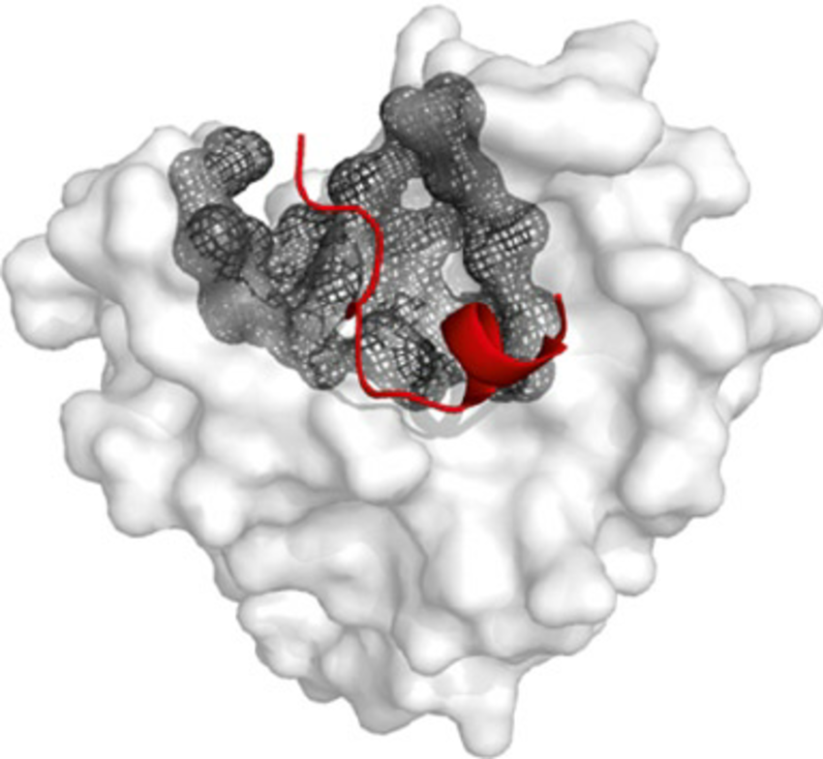
Binding sites
“Peptides tend to bind in large pockets on protein surfaces”
-- London et al, 2012. DOI:10.1007/978-1-61779-588-6_17

Slide 13
Protein folding can help define a structure that we can use to rationalize binding sites, and ligands that bind to them.

Slide 14
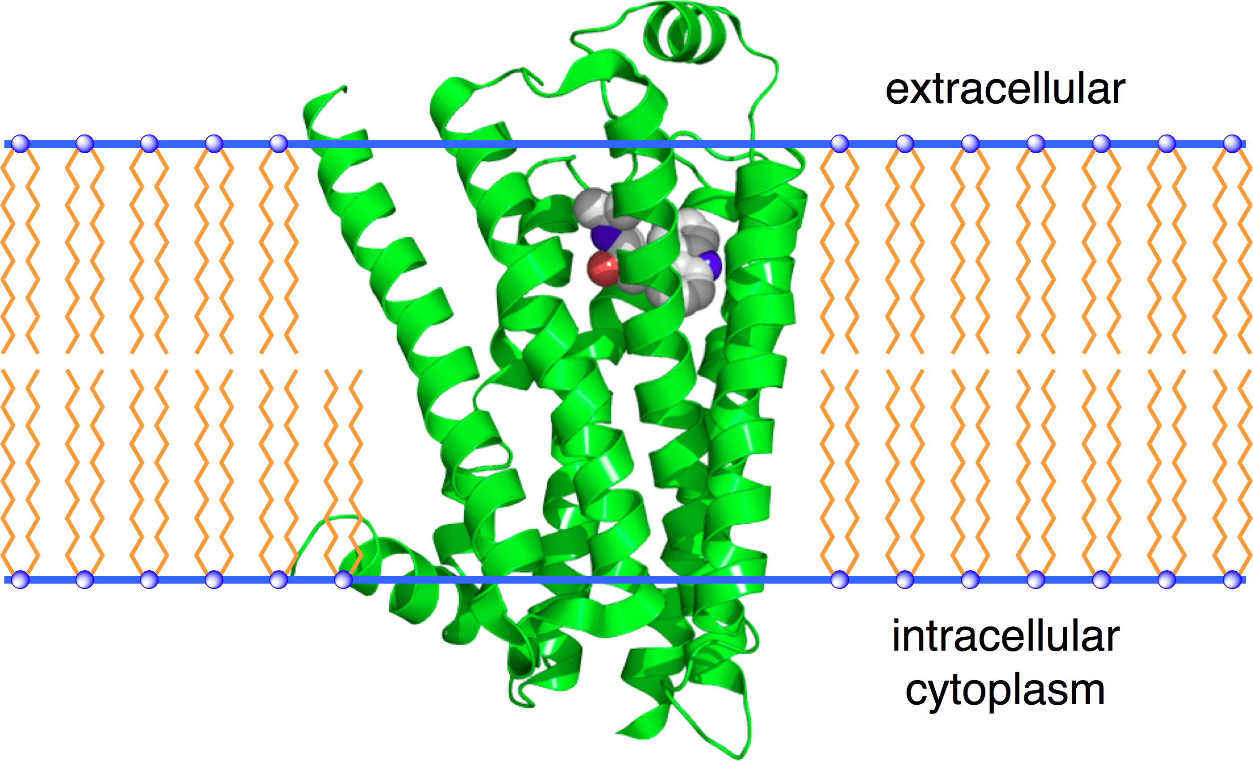
β1-adrenergic receptor
(β1-AR, ARDB1)
Important target:
Hypertension
Arrhythmias
Heart failure
Chest pain
Myocardial infarctions
Migraines
Anxiety

Slide 15
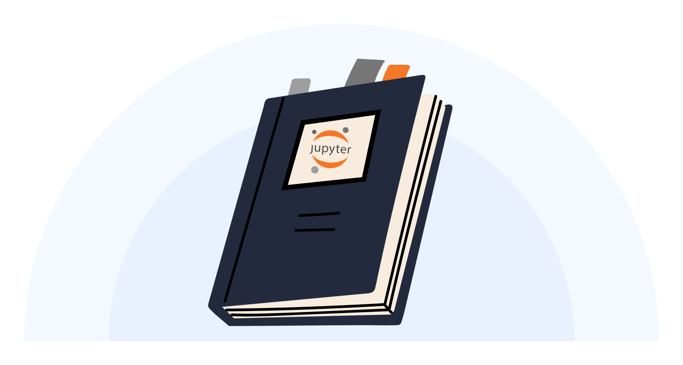
To the notebook!

Slide 16
Limitations

Slide 17
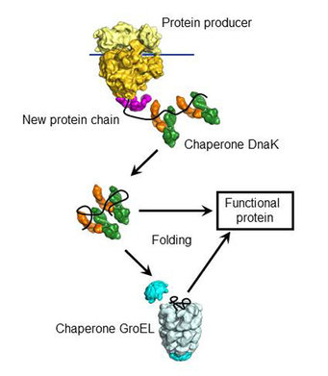
Current protein folding assumes Anfinsen's dogma
“... at least for a small globular protein in its standard physiological environment, the native structure is determined only by the protein's amino acid sequence.”
-- Anfinsen's dogma, 1973. DOI: 10.1126/science.181.4096.223
Notes:
Nobel Prize in 1972, added chemicals to disrupt the 3D structure of protein, removed the chemicals 3D structure retained

Slide 18
Current protein folding works on a static basis.

Slide 19
Conclusions

Slide 20
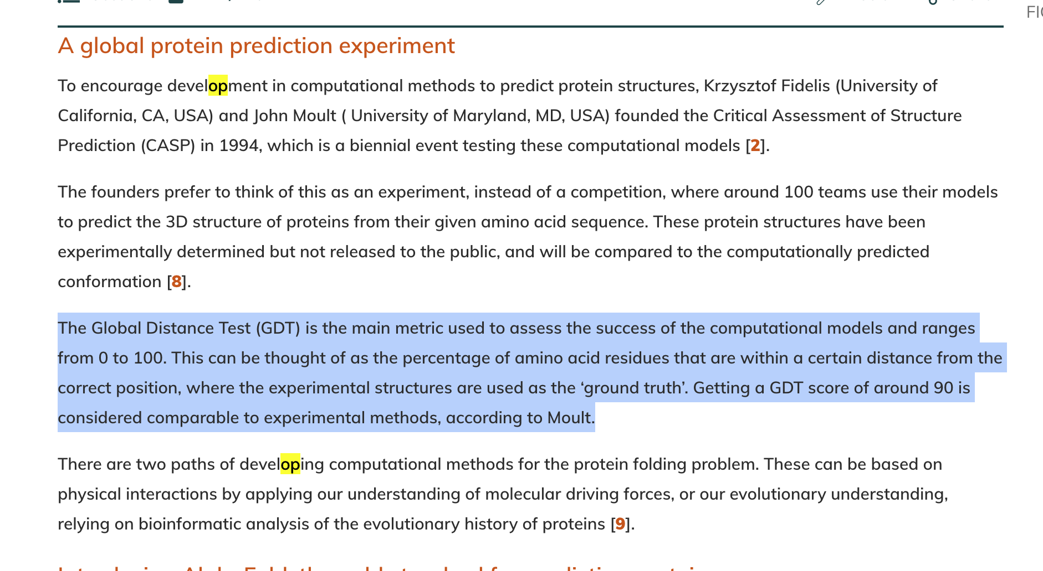
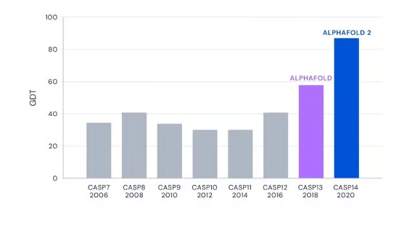
Paradigm shift
Notes:
Demis Hassabis and John Jumper, 2023 Albert Lasker Basic Medical Research Award — ~50% of the winners’ go on to a Nobel prize. Recent CASP entries are built off of AlphaFold 2

Slide 21
~$1-2 billion
… to discover one new drug¹
It won’t reduce drug costs in the short-term
~$7 million
… for preclinical costs²
~0.35%
… of the costs
1. https://www.cbo.gov/publication/57126, 2. https://www.knowledgeportalia.org/costs-r-d

Slide 22
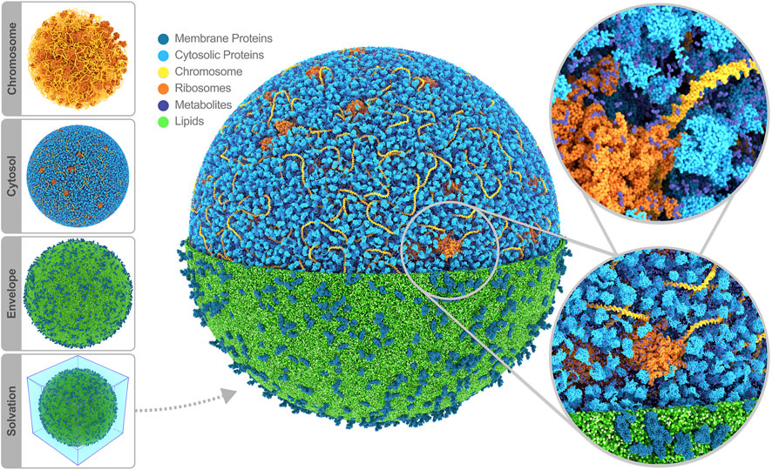
Ever so slightly closer to simulating, a whole cell

Slide 23
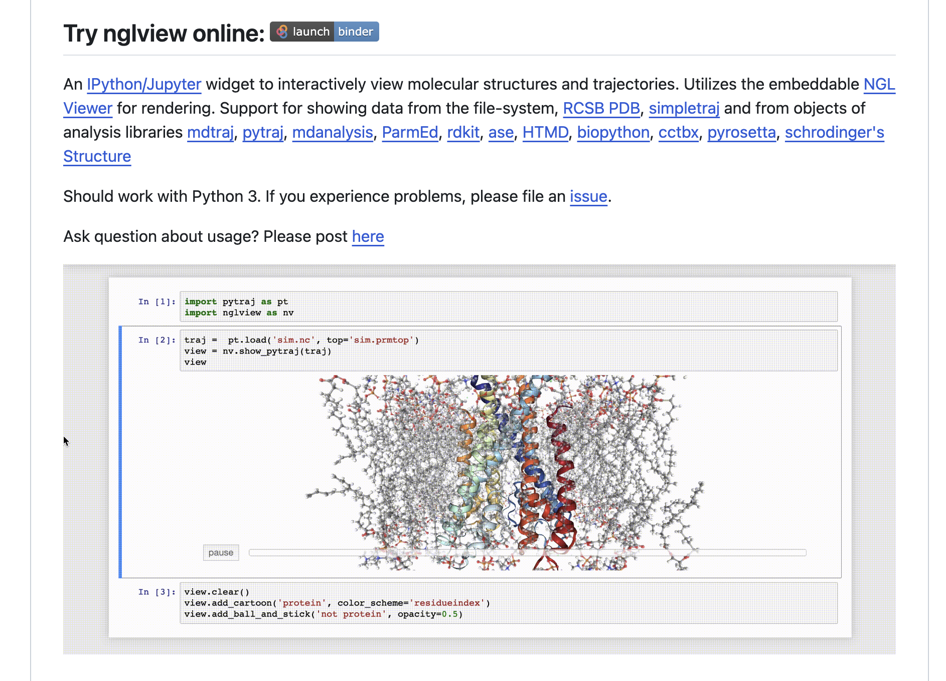

Tools
https://biopython.org/
https://github.com/nglviewer/nglview
https://www.rdkit.org/
https://github.com/google-deepmind/alphafold
Resources
https://www.nature.com/scitable - basic information
https://www.biorxiv.org/ — primary papers
https://string-db.org/ — interactions DB
https://www.rcsb.org/ — protein DB
https://alphafoldserver.com/ — AlphaFold 3
https://pubchem.ncbi.nlm.nih.gov/ —DB of bioactive molecules
https://go.drugbank.com/
https://www.science.org/content/blog-post/alphafold-3-debuts — Derek Lowe’s blog is really approachable

Slide 24
Thank you!
Questions?

